Slide 1
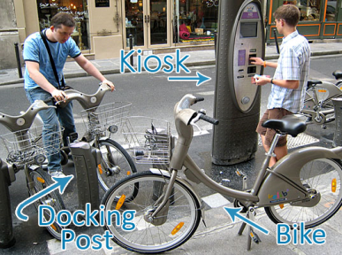
Public Bikesharing:
Understanding from Across the Globe
Susan A. Shaheen, Ph.D.
Lecturer and Co-Director
Transportation Sustainability Research Center, University of California, Berkeley

Slide 2
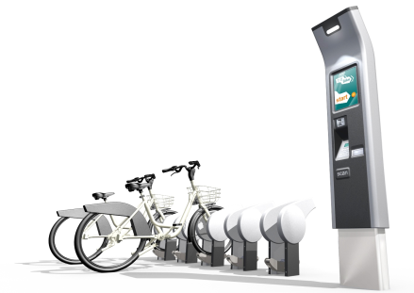
Overview
Public Bikesharing Definition / Generations / Bikes
Global & N. American Activity
Funding / Business Models
Pre-Launch Considerations
# of bicycles and stations, expansion
Marketing strategies
Bicycle Management
Bicycle Safety / Infrastructure
Technological Innovations
Public Transit Linkages
Conclusion
Notes:
Six key areas of discussion: 1) funding/business models, 2) pre-launch and expansion considerations, 3) bicycle management, 4) bike safety/infrastructure, 5) technological innovations, and 6) public transit linkages

Slide 3
Public Bikesharing
Short-term bicycle access
Provides users with a sustainable and environmentally-friendly form of public transportation
Targets daily mobility
Bicycle reservations, pick-up, and drop-off are self-service (IT-based)
Notes:
--Form of public transportation; does not address university
and business bikesharing programs (with exception of U of T)
--Intended for “point-to-point” trips; typically one way
--Designed for short trips under 3 miles and 30 minutes

Slide 4
Notes:
--1st generation: 1965 Amsterdam “white bikes”
--2nd generation: 1995 Copehagen
--3rd generation: 1998 Velo a la Cartes in Rennes, France; emphasis on user accountability (use of credit or debit cards); Velib—20,600 bikes and over 1450 stations
--Theft: Minneapolis had one bike theft in 2011; DC/Arlington’s Capital Bikeshare theft rate is less than 1%

Slide 5
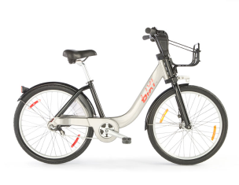
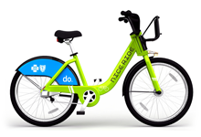
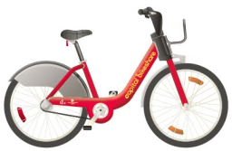
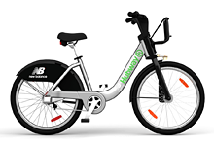
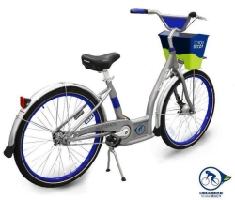
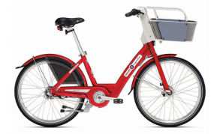
Bicycles
Capital Bikeshare
BIXI Montreal
Nice Ride MN
Hubway
DecoBike
Denver B-Cycle
In general, programs use bicycles with 3-gears and adjustable seat height
B-Cycle bikes are equipped with baskets
BIXI bikes are equipped with a rack and a bungee cord
Notes:
--Rugged, urban juggle bikes
--Proprietary bolts, axels, nuts, fenders, and handle bars
--BIXI bicycles:
Aluminum frame - light, strong, durable.
One-piece handlebar covers and protects all components.
All cables and derailleur covered for better protection.
Chain protector integrated into bike structure.
Active lighting - front and back, always on when riding.
Front and rear internal brakes for greater safety.
Adjustable seat positioning - standardized through entire fleet of bikes.
Suitable for a wide range of riders.
Low center of gravity for greater stability.
Tires - made for the urban jungle.
B-Cycle- “Trek” bicycles
aluminum frame that’s reinforced at the downtube and has a brawny triple-crown fork
Propelled by Shimano’s 3-speed Nexus drivetrain, which includes reliable internal braking and easy shifting.
Eco-friendly, power-generating Dynamo hub that illuminates safety lights on the front and rear of the bike. The front and rear lights are always on when the bike is in motion.
front basket that will stabilize handling and increase cargo carrying capacity
Tires/wheels: Bontrager reinforced-sidewall rubber mated to robust, 36-spoke triple-cross wheels
They use special proprietary bolts, axel nuts, fenders and handlebars. There’s nothing that’s off-the-shelf and usable with other bikes, so there’s no reason to try stealing any of the parts

Slide 6
Global Activity
As of Spring 2011:
136 bikesharing programs in approximately 160 cities around the world
Over 236,700 bicycles and 13,500 stations on the roads worldwide
Notes:
--Velib: 20, 600 bikes and over 1,450 stations
--Wuhan: 70,000 bikes and over 1,280 stations
--BIXI (Montreal): 5,050 bikes and over 400 stations
--Capital Bikeshare: 1,200 bikes; 140 stations

Slide 7
N. American Bikesharing Activity Program Launches
Notes:
- Tracking initial start up and stops Dec. 2011
- This tracks initial program start-up. For example, In 2008, only SmartBike DC launched. In 2009, the only program to launch was BIXI Montreal.
- List of planned programs in North America and their tentative launch dates:
* Baltimore B-Cycle: summer of fall 2012
* Chattanooga (TN) Bike Share: Spring (April) 2012
* NYC Bikeshare: Summer (July) 2012
* SF Bikeshare: Summer (July) 2012
* Chicago (IL) Bikeshare: Summer 2012
* Kansas City Bikeshare (BikeshareKC): Summer (June) 2012
* Lansing, MI Bikeshare: Spring 2012 * Austin Bikeshare: 2013
* Fullerton, CA Pilot Bikeshare: 2013?
* Houston B-Cycle (Possible 2012 launch. Has not yet gone live)
* Long Beach, CA (Possible 2012/2013 launch)
* Long Beach, NY (Possible 2012 launch. Has not yet gone live)
* Los Angeles, CA (2012-2013)
* Portland, OR (Planned 2013 launch)
* Santa Monica, CA (Planned 2016 launch)

Slide 8
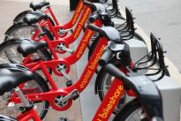
Bikesharing: North America
As of March 2011:
Over 9,000 shared bicycles and 750 stations, 6 operations
As of February 2012, there were 17 operations:
Capital Bikeshare,
BIXI (3),
B-Cycle (10),
NiceRide,
Hubway, and
DecoBike
Several more planned (NY, SF, Chicago)
Notes:
Planned: Chicago – 3,000 bikes; 300 solar powered self-service, pickup/drop off locations; summer 2012; Alta Bicycle Share (operator) and Public Bike System Co. (manufacturer of BIXI) equipment supplier

Slide 9
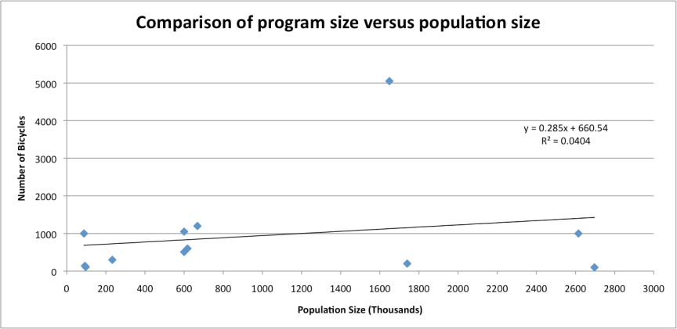
Program Size vs. Population Size North America
Notes:
--12 programs
--Majority of programs under 1,000 bikes (7 of 12); 5 above 1000 bikes; and 4 under 500 bikes
Population Size / Number of Bicycles
Boston, MA: 617,000 / 600; 1,028:1
Boulder, CO: 97,000 / 110; 881: 1
Broward, FL: 1,740,000 / 200; 8,700:1
Chicago, IL: 2,697,000 / 100: 26,970:1
Denver, CO: 600,000 / 510: 1,176:1
Madison, WI: 233,000 / 270: 863:1
Miami Beach, FL: 88,000 / 1,000: 88:1
Montreal, CA : 1,649,000 / 5,050 (HIGHEST NUMBER): 326:1
San Antonio, TX : 93,000 / 140; 664:1
Toronto, CA : 2,615,000 / 1,000; 2,615:1
Twin Cities : 668,000 / 1,200; 556:1 (Nice Ride)
Washington DC : 600,000 / 1,050; 571: 1 (Capbi)
US Census data for “city” population

Slide 10
Program Size vs. Population Size Worldwide
City | Population | Bicycles
Barcelona, Spain | 1,600,000 (city) | 6,000
Hangzhou, China | 7,000,000 (city) | 60,600
London, UK | 7,800,000 (city) | 8,000
Lyon, France | 475,000 (city) | 4,000
Paris, France | 2,200,000 (city) | 20,600
Wuhan, China | 9,700,000 (city) | 70,000
Notes:
--Largest programs; population/bike ratios
Paris: 107:1 and Hangzhou: 116:1 (the lowest)
Wuhan: 138:1 Velib: 20,600 bikes; over 1,450 stations
Lyon: 119:1 Hangzhou: 60,000 bikes, over 2,416 stations
London: 975:1 Wuhan: 70,000 bikes, nearly 1,220 stations
Barcelona: 267:1 Barclay’s Cycle Hire of London: 6,000 bikes and 400 stations

Slide 11
North American Activity Program Expansion Based on Bicycle Numbers
Notes:
The year noted in parentheses is the year the program launched.
In 2010, the following programs officially launched:
Denver B-Cycle
Nice Ride MN
Chicago B-Cycle
Des Moines B-Cycle (pilot)
Capital Bikeshare
Note, at this time, Smartbike DC and BIXI Montreal were still operating.
In 2011 the following programs officially launched:
DecoBike (Miami Beach)
San Antonio B-Cycle
Hawaii B-Cycle (Pilot)
Boulder B-Cycle
Madison B-Cycle
Omaha B-cycle
Spartanburg B-cycle
Hubway
Broward B-Cycle
BIXI Toronto
BIXI Ottawa/ Gatineau
Golden Community BIke Share (GCBS)

Slide 12
U.S. Activity Initial Funding
(Based on Dollar Amount)
Notes:
--Public funds (e.g., foundations, such as Gates Family Foundation, Tides Foundation/Google)--$478,000 (2%)
--State (e.g., Virginia Department of Rail and Public Transportation)
--Local (e.g., Arlington County, City of Boulder)--$250,0000 (4%)
--Federal (e.g., CMAQ, FTA, Federal Non-Motorized Transportation Pilot Program, Federal Energy Conservation Block Grant, Federal Stimulus, )--$6,245,000 (57%)
--Private (e.g., Kaiser, Trek, Blue Cross and Blue Shield of Minnesota, New Balance)--$4,020,000 (37%)
1. Capital Bikeshare:
The $6M bikeshare program is funded in the District by the U.S. Department of Transportation’s Federal Highway Administration under their Congestion, Mitigation and Air Quality (CMAQ) fund, local funding (80/20). The Arlington system includes $835,000 for capital through a combination of funding from a grant through the Virginia Department of Rail and Public Transportation, Arlington County transportation funding and sponsorships by the Crystal City BID and the Potomac Yard Transportation Management Association.
2. Nice Ride MN
Funding for the initial $3 million capital cost included $1.75 million from the federal Nonmotorized Transportation Pilot Program administered by Bike Walk Twin Cities and Transit for Livable Communities (TLC), $1 million of tobacco settlement proceeds from Blue Cross and Blue Shield of Minnesota (Blue Cross), and $250,000 from the City of Minneapolis Convention Center fund.
3. Hubway
Hubway is completely funded by grants totaling $4.5 million including $3 million from the Federal Transit Administration (FTA), $450,000 from the Boston Public Health Commission (BPHC) and $250,000 from the Metropolitan Planning Organization’s Congestion Mitigation and Air Quality (CMAQ) grant program.
4. Denver B-Cycle
got initial funding from a $1 million donation from the Denver 2008 Convention Host Committee
Kaiser Permanente stepped up to serve as the founding funder of Denver B-cycle, and the organization’s three-year $450,000 community benefit sponsorship is a visible display of confidence in the long-term promise of the system. Along with Kaiser Permanente’s presenting sponsorship, the contributions from key community partners — Denver 2008 Convention Host Committee, the Walton Family Foundation, the Anschutz Foundation, Gates Family Foundation, the University of Colorado Housing Authority, and the Gary Williams Company — helped lay a foundation for success of bike sharing in Denver. In addition to private foundation and corporate support, Denver Bike Sharing was awarded $210,000 in 2009 from the federal Energy Efficiency and Conservation Block Grant program. No city tax dollars are going to Denver Bike Sharing.
5. Boulder B-Cycle
Over half of the $1.1 million dollar cost to launch the City’s existing B‐Cycle system was raised through a grassroots fundraising effort led by Boulder B‐cycle and collected in the form of grants, donations from individuals, and contributions from businesses of all sizes. The City of Boulder committed staff time and approximately $250,000 in city funds, as well as $250,000 of the City’s formulaic federal American Recovery and Reinvestment Act Environmental Efficiency and Conservation Block funds in support of planning and initial capital investment of the existing B‐cycle system.
The Gates Family Foundation provided a $50,000 grant to aid with start-up costs related to the planning and purchasing of the B-cycle launch system.
The Google Community Grants Fund at the Tides Foundation has provided a $25,000 donation to Boulder B-cycle, as part of Google’s commitment to support innovative ways for using Internet-based technology to reduce environmental impacts and improve the quality of life in the communities where it operates. $45,000 from the City of Boulder
6. Madison B-Cycle
Wisconsin-based Trek Bicycles have donated US$1 million to kick-start a new B-Cycle bike sharing program in the state’s capital city of Madison. It will fund the program at a cost of $700,000 annually for five years.
7. San Antonio B-Cycle
ARRA Funding for Phases I and II: Energy Efficiency Community Energy Efficiency Community Block Grant (EECBG) Block Grant (EECBG) $920,866.00 Communities Putting Prevention Communities Putting Prevention to Work (CPPW): $324,325.00. San Antonio Bike Sharing receives its funds through grants, sponsorships, memberships, and transaction fees.

Slide 13
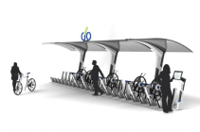
Business Models/Funding
Providers range from local governments to transport agencies, advertising companies, for-profit, and non-profits
Funding sources include: public & private grants, corporate sponsorships, outdoor advertising, loan financing, etc.
Nice Ride MN procured $1.25m in sponsorship its first year
Boulder B-Cycle received a $250,000 federal grant from the City of Boulder
Programs must carefully evaluate operating models:
1) Public agency owns & operates (e.g., Youbike, Taiwan)
2) Public agency owns but private company operates
3) Private company owns & operates (e.g., Next Bike, Germany)
Notes:
--Advertising companies: JC DeCaux and Clear Channel
--Alta and B-Cycle – key operators in N. America

Slide 14
Business Models/Funding (cont’d)
Growing number of vendors, providers, service models, and technologies
Many programs now consider various (private and public) funding options:
Denver B-Cycle is funded through:
Individual foundation and government grants
Corporate sponsorships (Kaiser)
User memberships and transaction fees
In Barcelona, Bicing funds bikesharing through advertising and parking fee revenues (i.e., parking meters)
Montgomery County, MD is considering grants, parking district funds, tax credits, advertising, state fund bonds, etc.
Notes:
--Denver B-Cycle funded by: 1) Kaiser Permante;s 2) Foundations: a) Walton Family, b) Anschurtz Foundation, c) Gates Family; 3) Others: University of Colorado Housing Authority and Gary Williams Co.; 4) Federal: Federal Energy Efficiency and Conservation Block Grant (2009) of $210,000
--Trek is another major corporate sponsor (Madison B-Cycle)
--New Balance (Boston Hubway)--$5.7 million from New Balance
--Blue Cross and Blue Shield of Minnesota (Nice Ride)--$1 million tobacco settlement proceeds

Slide 15
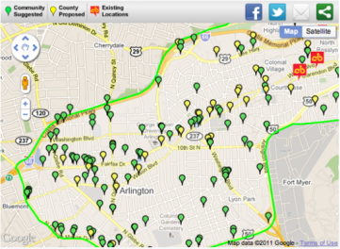
Pre-Launch Considerations
Number of bicycles and stations
Marketing strategies
Expansion approaches

Slide 16
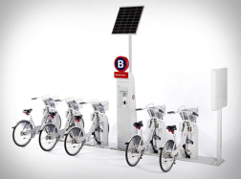
Determining # of Bicycles & Stations
Most successful programs have deployed stations within 300 meters of each other to facilitate availability:
Lyon - Velo'v: stations are 250 to 550 meters apart
Paris - Vélib: 250 to 350 meters
Barcelona - Bicing: 250 to 350 meters
Hangzhou Public Bicycle: about 300 meters
Notes:
--300 meters = 984 feet
--Ranges from 820 feet to 1,804 feet
--Close range facilitates availability and redistribution

Slide 17
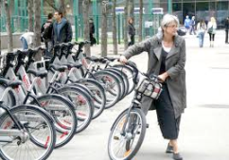
Tools and Techniques
Cities should first establish a primary geographic market and estimate program demand to deploy appropriate number of stations and bicycles.
A program that is too small, or does not meet demand, will have difficulty succeeding.
Mathematical tools and models created that allow cities to evaluate various bikesharing scenarios to assess program viability before launch and during operation
Notes:
--Raster-based GIS analysis
--Recommended reading: Krykewez et al (TRR 2010) paper: “Defining A Primary Market and Estimating Demand for Major Bicycle Sharing Program in Philadelphia, PA”
--Mathematical tools often address asymmetry issues
--Velib: Difficult to forecast extent of operational and personnel cost even with modeling tools

Slide 18
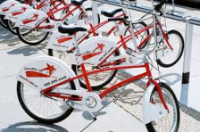
Bicycle/Station Expansion Capital Bikeshare Case Study
Programs may consider program expansion
In Arlington, Capital Bikeshare drafted four distinct scenarios and various principles for guiding growth in the CaBi system
Expansion principles include:
New stations should be within a ½ mile maximum of another station and preferably within a ½ mile of an existing station.
New stations should be located in areas with a significant presence of population, employment, and/or other attractions.
New stations should be located so bikesharing increases the reach of other modes, particularly public transit and walking.
Notes:
Additional Expansion Principles: (scenarios for next 6 years; public comment through April 15, 2012)
*Rebalancing bikes comprises a good percentage of operating costs, and these costs are lessened by dense station placement and appropriate station sizing. The greater the geographic dispersion of Arlington’s Capital Bikeshare stations throughout the County and through lower density neighborhoods, the more it will cost to operate the system
*New stations should serve a variety of trips purposes for a wide variety of users (age, race, income, gender).
*Arlington’s CaBi expansion should serve the needs of Arlington residents, employees, and visitors.
*New stations should be placed such that operating costs are minimized.
*CaBi expansion should use existing bicycle facilities (on-street bike lane, sharrows, and off-street trails) to the greatest extent possible, in concurrence with Arlington County’s established station location preferences. *New stations should be placed to expand the access to destinations located outside the County, particularly as neighboring jurisdictions place CaBi stations in activity centers within biking distance of Arlington. Four scenarios:
Existing Deployment Expansion – Add density to current corridors followed by a gradual expansion into adjacent neighborhoods with high station density
Connecting Through Neighborhoods – Connect through neighborhoods in central Arlington to form a north/south “inner loop” of stations that connect the existing CaBi corridors with Shirlington
New Corridors Expansion – Concentrate expansion in new corridors, Columbia Pike and Lee Highway
Trail Focused Expansion – Focus expansion along existing off-street bicycle facilities.

Slide 19
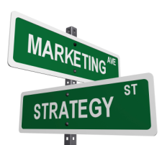
Marketing Strategies
Pre-launch marketing strategies for bikesharing are becoming increasingly popular.
Media outlets and social media have played key roles in raising awareness and generating program support.

Slide 20
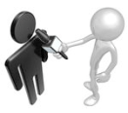
Marketing Strategies: Examples
Alta Bikeshare employs logo development, websites, public relations, social media, and marketing materials to gain exposure and membership prior to system launch.
London’s Barclay system pre-launch PR campaign generated more than 1,200 print and online articles, with 90% of coverage positive or balanced. Awareness rose from 37% in March 2010 to 82% post-launch.
BIXI Toronto required to secure 1,000 year-long membership pledges and 3 years of annual sponsorship pledges from private organizations before deployment. They employed social media and held public demonstrations.
Programs, such as Capital Bikeshare and NYC, generated program exposure by holding workshops where users and potential users provide feedback about station placement.
Notes:
--Logos, websites, social media
--PR to generate early awareness and membership/sponsorships
--Public demonstrations and workshops

Slide 21
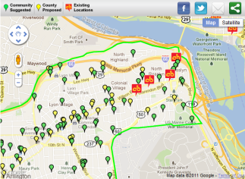
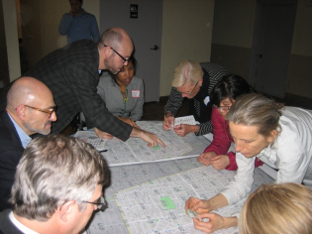
Public Involvement
At present, public meetings/workshops have been one of the most common ways for programs to engage the public
CaBi is holding public meetings to gather public commentary for future station placement
NYC has held public workshops where the public can share their thoughts regarding future station placement
CaBi also partnered with Mobility Lab to create a crowdsourcing map where individuals could rate and suggest future stations
Notes:
--Need to integrate into the fabric of the community

Slide 22
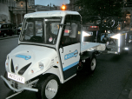
Bicycle Management
To run efficiently, bicycles must be redistributed to key demand locations frequently after use:
Mexico City uses EVs that pull trailers with a 27-bike capacity.
Denver uses trucks that burn compressed natural gas.
Vélib‘ uses natural gas powered vehicles to transport bikes from one station to another.
Hangzhou also employ trucks to redistribute bicycles.
BIXI employs redistribution trucks and on-board computers to provide drivers with real-time information on bicycle stations to facilitate a speedier and more efficient response to bicycle shortages and station overcrowding.
Capital Bikeshare has groups of “rebalancers” who drive vans to relocate bicycles. Vans have software that display station status.
Notes:
--EVs, CNG, on-board computers that display station status

Slide 23
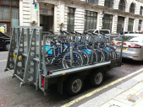
Bicycle Management (cont’d)
It is important that new systems incorporate bicycle redistribution improvements that are more sustainable/efficient.
Future models should also consider ways to incentivize rider-based redistribution.
Employing demand-based pricing in which members receive a price reduction or credit for parking bicycles at empty docking locations
Vélib’: Some stations, called V+, are located above an altitude of 60 meters. Riders are granted an additional 15 minutes to return bikes from non-V+ stations to V+ stations.
Capital Bikeshare implemented a “Reverse Rider Rewards Program” to encourage annual members to move bikes from “typically full” stations to “typically empty” stations during the weekday morning rush hours.
Notes:
--Rider helps with redistribution
--Extra time: Velib
--Price/credit reduction—e.g., CapBi “Reverse Riders Rewards Program”

Slide 24
Safety
Larger numbers of cyclists can make motorists more aware and less likely to collide with them.
A large cycling presence may not solve safety issues, if bikesharing attracts a large influx of newer cyclists.
To date, no bikesharing program requires a cycling educational program as a prerequisite to subscription.
Safety information tends to be displayed on handlebars of shared bicycles, on kiosk panels, and/or on pamphlets distributed with subscription cards.
Implementation of laws and legal measures in support of cycling can help mitigate safety concerns.
Prior to Vélib’s launch, the city’s mayor lowered vehicle speed limits, built more bike paths, and changed street directions by creating more one-way streets. This helped reduce private vehicle traffic by 20%.
Notes:
--Need for training, particularly with newer cyclists
--#s increase safety
--Laws: lower speed limits, more bike paths, and more one-way streets

Slide 25
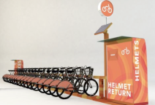
Safety (cont’d)
Bikesharing helmet use has sparked great debate within cycling community.
Programs where helmet use is optional (for non-minors) have experienced most success and usage.
Programs with mandatory helmet laws have experienced lowest use rates (e.g., Melbourne).
SandVault created fully-integrated helmet dispensing system where helmets are sanitized. This would allow riders to either drop off a used helmet or purchase it.
Other strategies include painting bike lanes bright colors to increase visibility and adding advance stop lines to minimize potential turning conflicts.
Notes:
--SandVault.com
--Based in Richmond, British Columbia, Canada
--Melbourne: Relocated some of its stations to the suburbs
--Bike share engineers at SandVault, originators of the Public Bike Share system, have come up with a way to share helmets, too.
SandVault calls the HelmetStation the first fully integrated helmet dispensing system.
Others have tried the concept of dispensing helmets through a vending machine - but while practical, it's not exactly a green solution. SandVault said its HelmetShare helmets (rental during a bike share session is estimated to cost approximately $1) will be "recyclable" because they will be sanitized upon their return to the bike sharing kiosk, before being rented out to a new user.

Slide 26
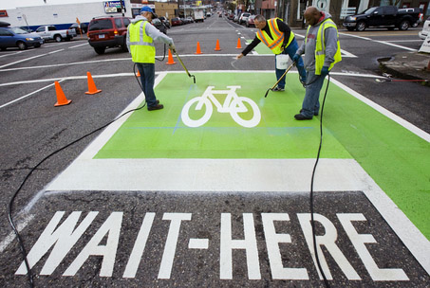
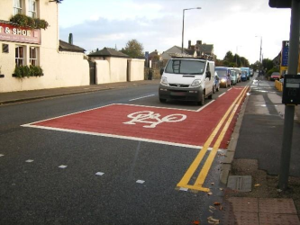
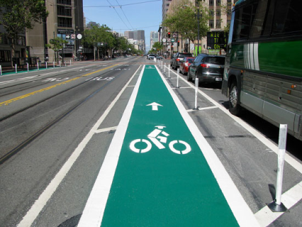
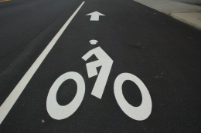
Safety (cont’d)
Notes:
--Examples of painting bike lanes bright colors
--Advance stop lines to minimize potential turning conflicts

Slide 27
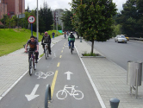
Bicycle Paths
Cities with successful bikesharing programs have expanded cycling infrastructure.
Bike lanes in Paris expanded from 122 km in 1998 to 399 km in 2007.
Barcelona had less than 10 km of bike lanes in 1990, but increased to 155 km of bike paths by 2008.
In Germany, cycling networks increased from 12,911 km in 1976 to 31,236 km in 1996.
Between 2000 and 2007, NYC DOT built over 200 miles of bike lanes and saw commuter cycling grow by 77%.
Prior to Ecobici’s launch (Mexico City), city officials committed to build 186 miles of bike lanes by 2012 to encourage cycling.
Notes:
--Many examples of expanded bike paths
--Paris expanded to 399 km (2007)
--Barcelona expanded to 155 km (2008)
--NYC built over 200 miles of bike lanes and saw commuter cycling grow by 77%
-- Mexico City will build 186 miles by 2012

Slide 28
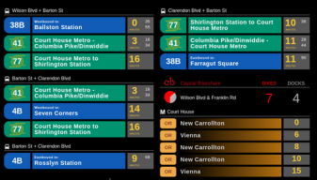
Technological Innovations
Incorporation of real-time information has offered notable bikesharing improvements
Capital Bikeshare users have access to real-time data on bicycle and dock availability. They now display upcoming public transit connections on indoor flat-panel display (or LCD) screens at local establishments.
While bikesharing data are still limited, technology has also made it possible for programs (such as B-Cycle and Capital Bikeshare) to document distance traveled and more accurately estimate carbon emission impacts.
Capital Bikeshare LCD screen displaying transit connections. Technology by Mobility Lab →
Notes:
--B-Cycle – GPS device
--BIXI – RFID tags/chips
If programs collect bikesharing usage data, they typically do so through GPS technology and utilize software to translate that data. Here is a B-Cycle example:
“B-cycles are equipped with an internal GPS device that tracks the bike’s trips. Other technology associates each trip with the member who checked out the bike. After this information is transferred to B-cycle’s computers, algorithms translate the trip information into estimates of the number of calories burned and carbon emissions avoided (as compared to the use of an average automobile for the same trip). If there are technical errors with the data collection or transfer, an estimate will be applied and clearly noted as such.”
Other programs, like BIXI, use RFID (Radio Frequency Identification) tags/chips to track usage data.

Slide 29
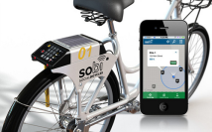
Technological Innovations (cont’d)
Allowing users to check bicycle or parking availability via text message, website, or smartphone application has increased user convenience.
Capital Bikeshare, Nice Ride & New Balance Hubway users can download “Spotcycle“ on their smartphones to access station updates.
BING has developed a free standing, non-docked bicycle available for checkout via the Internet and text message. Bicycles are tracked by GPS; when removed from program’s designated area, the wheel tightens. If bicycle is outside of desired bikesharing area for more than 15 minutes, the bike’s coordinates are dispatched to operator.
Notes:
BING: free-standing bike, Internet/text checkout, GPS tracking, wheel tightens when removed from area, and bike coordinates dispatched after 15 minutes outside designated area
--Source for Bing technology noted above: http://www.designbuzz.com/inclusive-bike-sharing-concept-rethink-rebike-recycle.html (Denmark) --Spotcycle App for smartphone users now offers updates on bikes/stations for the following programs: 1) London: Barclays Cycle Hire
2) Melbourne: Melbourne Bike Share
3) Montreal: Bixi Montreal
4) DC: Capital Bikeshare
5) Minneapolis: Nice Ride.

Slide 30
VPPP City CarShare/E-Bikesharing
Funded by a grant from Federal Highway Administration’s Value Pricing Pilot Program; City CarShare in SF will implement
City CarShare plans to integrate e-bikes with its existing carsharing service
Grant funds cover TSRC, UCB evaluation and about 40% of costs over 3 years for 90 e-bikes at about 25 locations
Plans to roll out 45 bikes in the second half of 2012 and 45 more by the end of 2013, mostly in SF, as well as Berkeley
Cargo e-bikes and/or trailers will also be available
Notes:
--11 out of 25 locations might have access to trailers/cargo bikes
--3 year project
--30-month implementation period
--Possible ebike vendors: Elite Electric Bikes, PiMobility , Giant, iZip (Currie)

Slide 31
Notes:
--50 people; peak use 10am to 3pm
--20% regular users; do not have reservations; two-way model
--iZip bikes; owner is Currie; 20 mile range; 12 batteries for 7 bikes (about 1.5 batteries/bike)
--Accell bought Currie; leading ebike maker in Europe; batteries weigh 9 lbs.

Slide 32
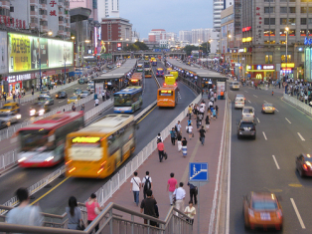
Public Transit Linkages
Bikesharing can provide public transit providers with a critical last-mile solution.
Linkages to rail, bus, and BRT
Bikesharing serves as a complement to public transit—by extending its range and providing more capacity.

Slide 33
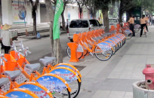
Multi-Modal Linkages
In 2011, Guangzhou, China was awarded Sustainable Transport Award for transportation advances and improvements.
World-class BRT system, which includes bikesharing. Guangzhou BRT integrates with bike lanes, bikesharing, and Metro stations. Program also employs a single card that pays for buses, bikes, and Metro.
In Summer 2011, City of Berlin began a 3-month trial where members could use a single Mobilitätskarte (mobility card). Card offered access to the Call-a-Bike StadtRAD bikesharing system and linked to the train, tram, subway, bus, and an electric carsharing program.
Notes:
--Multi-modal connections to Call-A-Bike
--Flinkster-Carsharing of Deutschen Bahn was electric carsharing program in the Berlin trial.

Slide 34
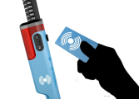
Smart Card Integration
Allows users to access transportation modes with swipe of a card
Enables service providers to collect data
Size of a credit card and stores/transmits data via RFID
Challenges for implementing include establishing fare rates and planning/coordinating among agencies
Bologna, Italy has introduced an integrated public transport fare system for trains and buses called STIMER/ MI MUOVO. Annual integrated bus and train season ticket ‘MI MUOVO’ will eventually become an all encompassing mobility card, linking up train, bus, bikesharing, carsharing, car pooling, taxi, park & ride parking areas, and electric recharge device services.

Slide 35
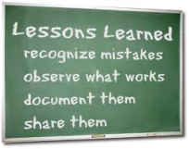
Conclusion
As bikesharing continues to expand, lessons from previous and current bikesharing programs have led to greater understanding of implementation and operational procedures.
Obstacles, such as short usage periods (revenue), helmet use, lack of cargo space, exposure to weather conditions, funding/business models still raise questions.

Slide 36
Acknowledgements
California Department of Transportation
Mineta Transportation Institute
Stacey Guzman and Dr. Hua Zhang, UC Berkeley
Foursquare Integrated Transportation Planning

Slide 37
www.tsrc.berkeley.edu

